Slide 1

Paris Meeting Goals
Peter Wittenburg
Max Planck Computing & Data Facility

Slide 2

Goals
Discuss the FDO Framework
defining requirements, enabling implementations
Come to an agreed Declaration
send this declaration to other DOers to send a signal
Probably need two groups to act
a Steering Group as pace maker towards „operationalisation“
a Technology Group to push specifications and to launch RDA activities about further details to be discussed
(type registry -> type ontology)
(should install a small kickoff group to work out suggestions)

Slide 3
Agenda (please, stick to time slots)
13.10 Introduction to FAIR DO (Carlo: Peter, Luiz)
13.45 Views from Community Experts (Francoise: Dimitris, Tobias,
Koenraad, (Massimo), Barend, Roberto)
16.00 Coffee Break
16.30 Further views on FDO (Bob: Edit, Carlo, Larry summarising)
19.30 Joint Dinner
9.00 Views from Technologists (Erik: Christophe, Jonathan, Ray,
Tian Ye, Klaas, Mark)
10.00 Coffee Break
10.30 Comments on Agreement and Governance Structure (Jean
Francois: intros by Barend & Rob, comments: Edit, Mark,
Beth, Michel)
11.45 Conclusions (George)
13.00 Lunch/end

Slide 4
From Kahn Papers to RDA DFT Model
Peter Wittenburg
Max Planck Computing & Data Facility

Slide 5
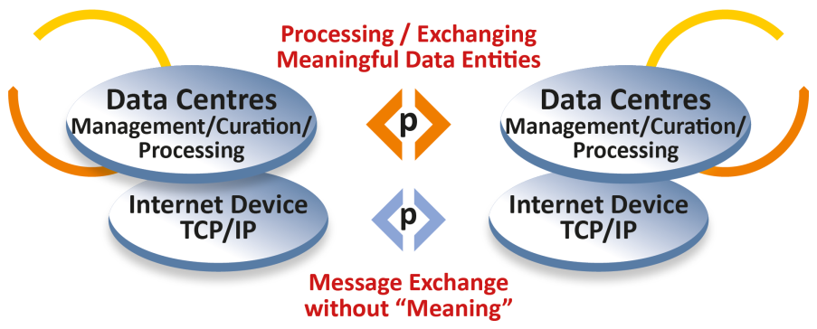
Looking back
some
applications
FTP
SMTP
GOPHER
etc.
82/85
complex,
many different types,
scientifically driven
„simple“, few types,
technologically driven

Slide 6
Looking back
some
applications
many
applications
FTP
SMTP
GOPHER
etc.
WWW
HTTP
HTML
URI
91/94
82/85
complex,
many different types,
scientifically driven
„simple“, few types,
technologically driven

Slide 7
Looking back
02
„large“
repositories
some
applications
many
applications
Handle
System
Publishers
DOI
FTP
SMTP
GOPHER
etc.
WWW
HTTP
HTML
URI
92/96
02/12
91/94
82/85
complex,
many different types,
scientifically driven
„simple“, few types,
technologically driven

Slide 8
Looking back
10/12
DO
Architecture
02
„large“
repositories
some
applications
many
applications
Handle
System
Publishers
DOI
FTP
SMTP
GOPHER
etc.
WWW
HTTP
HTML
URI
A Framework for
Distributed Digital
Object Services
(Kahn & Wilensky)
92/96
02/12
91/94
82/85
95/06
complex,
many different types,
scientifically driven
„simple“, few types,
technologically driven

Slide 9
Looking back
RDA DFT
Core Model
DO
Architecture
14
10/12
02
„large“
repositories
some
applications
many
applications
Handle
System
Publishers
DOI
FTP
SMTP
GOPHER
etc.
WWW
HTTP
HTML
URI
A Framework for
Distributed Digital
Object Services
(Kahn & Wilensky)
92/96
02/12
91/94
82/85
95/06
complex,
many different types,
scientifically driven
„simple“, few types,
technologically driven

Slide 10
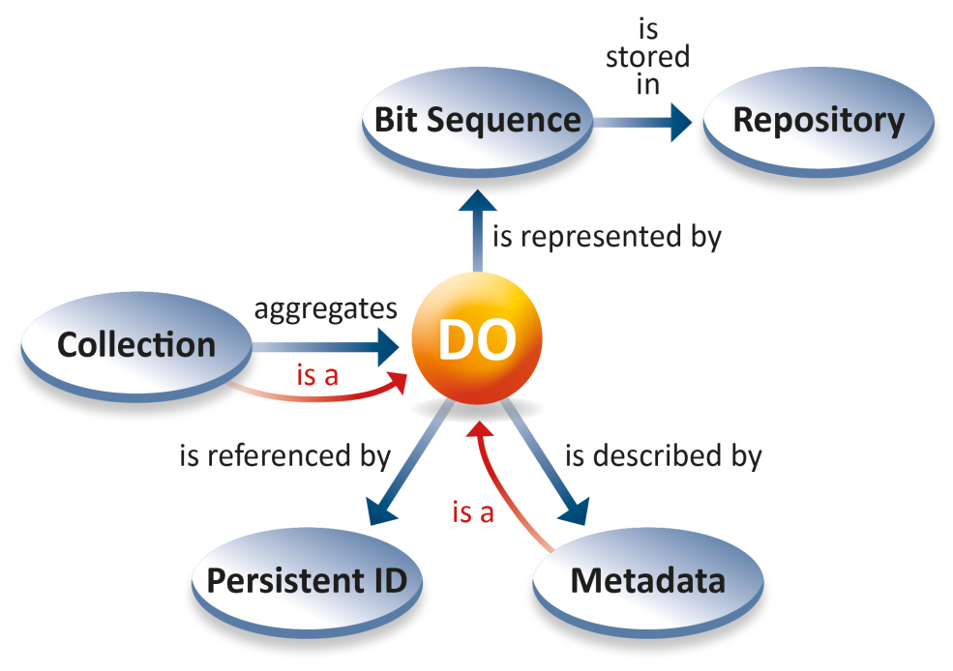
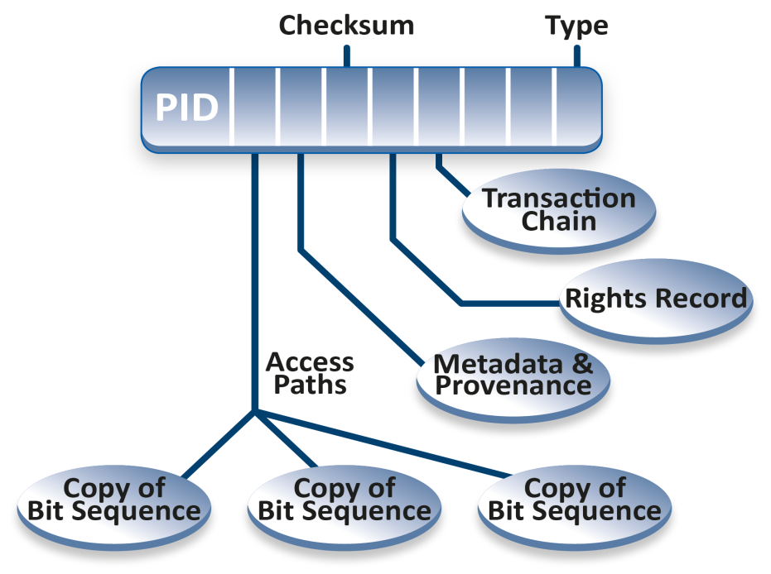
Framework for DO services and RDA DFT
Kahn & Wilensky: DO is an instance of an abstract data type that has two
components, data and key-metadata. The data is typed. The key-metadata includes
a handle.
DFT: a DO has a structured bit sequence stored in some repositories, is assigned a
PID and is described by metadata. DOs can be aggregated to collections which are also DO. Metadata descriptions are DOs.
The DO‘s PID Record is resolved to essential attributes enabling human/machine actions.

Slide 11
RDA Activities
Digital Objects
abstract from concrete content at DO management level
(data, software, metadata, assertions, etc.)
offer stable binding through PID record
Data Type Registry Groups
offer options to define and register types
offer options to link types with operations
Kernel Attribute Groups
definition of a core set of kernel attributes
Collection Group
definition of construction of collections
Metadata Groups
working hard to structure metadata domain
Practical Policy Group
handbook full of micro procedures

Slide 12
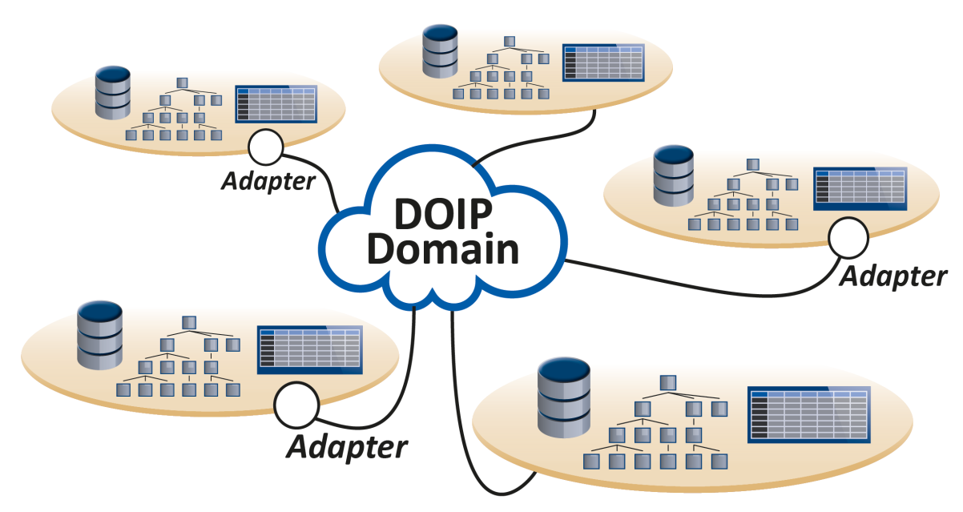
Advancements at CNRI & DONA
improved specification and implementation of DO Architecture
DOIP V2.0 specifying unified client – DO Server interaction
DOIP V2.0 Implementation
CORDRA DO Server Reference Implementation
of course: consolidation of Global Handle Resolution System

Slide 13

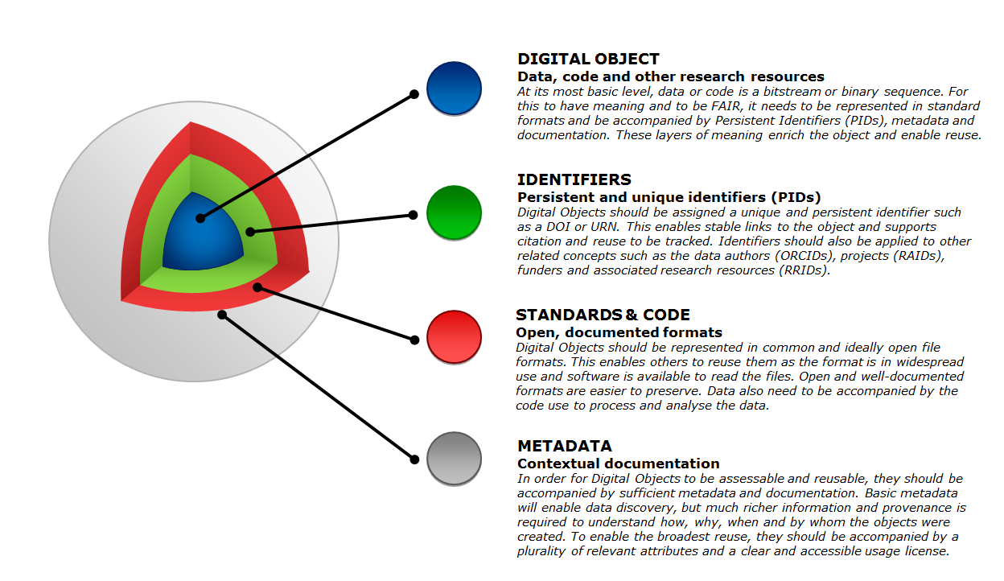
Recent Steps from DO to FAIR DO
Term „FAIR Digital Object“
discussing FAIR support of DOs
November 2018

Slide 14
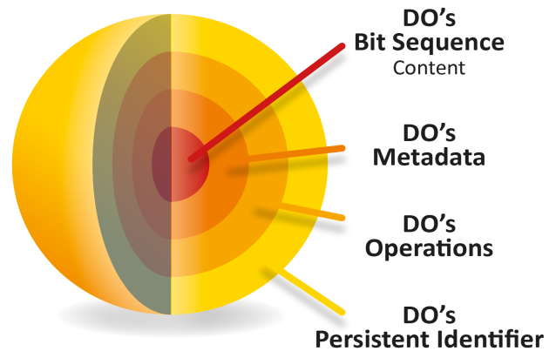
Ongoing Discussions about FAIR Support of DOs
some papers
Wittenburg (DAMDID, Okt 2018)
Schultes & Wittenburg (not finished)
„GOing FAIR vs DOing FAIR“
Strawn
GEDE DO discussions (150 RI experts)
summary
basic FAIR Principle support
resolution to structured record with defined semantics of attributes but not mandatory
metadata binding required but no statement about metadata
collection inclusion but no statement about „construction“
Metadata
Collection
DTR
Cloudy
RDA
DFT
Kernel Attributes
PP

Slide 15


Missing
need steps to integrate and extend to meet FAIR Indicators
need an agreed Framework for FDO as next step
need an authority for FDO
Luiz will go into detail

